Slide 1
How Solar PV works

Slide 2
Today we will learn
How solar panels work
How to design a solar PV system

Slide 3
Solar PV
Solar PV is short for SOLAR PHOTOVOLATICS
Phot0 – means ‘light’
Voltaic- means electricity produced by chemical action

Slide 4
How Solar PV works

Slide 5
Think-Pair-Share
We’re going to answer the questions on the video together here: https://ed.ted.com/lessons/how-do-solar-panels-work-richard-komp/think?question_number=1
First, try and think of the answer.
Then discuss it with your partner.
Then we’ll share our thoughts with the class and answer the question together.

Slide 6
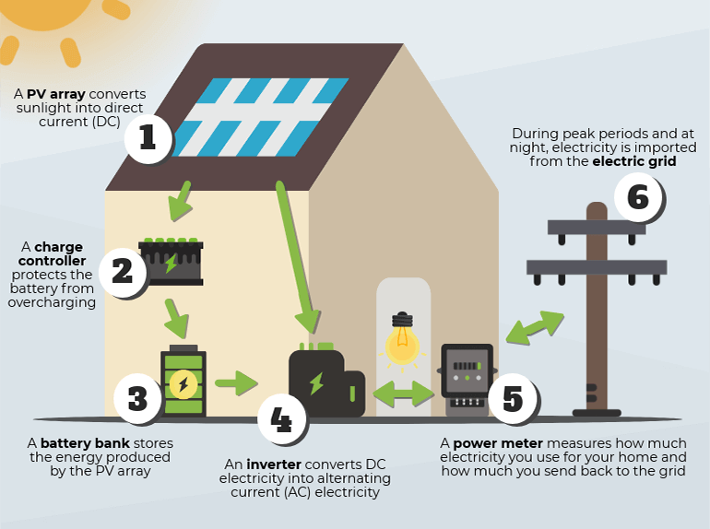
Parts of a solar PV system

Slide 7
What roof should you put panels on?
You need to consider:
- What roof space is available
-What way the roof is facing
-If there are any tall trees or objects on the roof that will ‘shade’ the panels (cast a shadow on them)

Slide 8
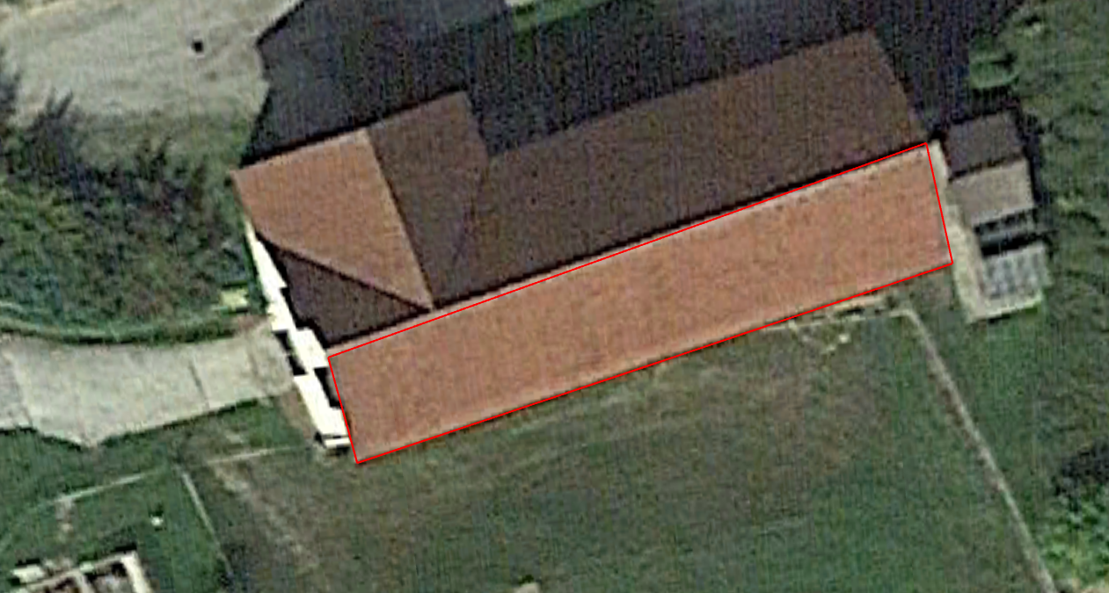
Let’s look at a roof together. This roof here has lots of space.

Slide 9
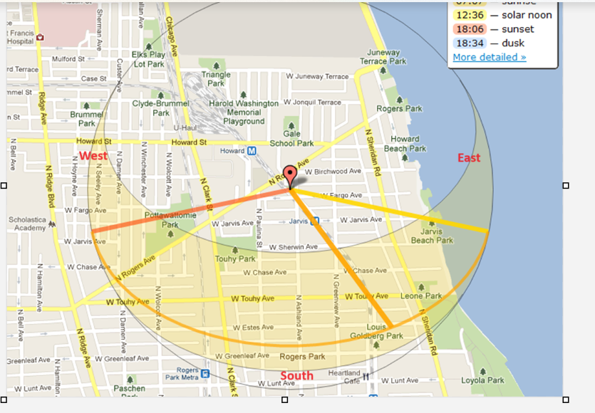
Is it facing the right way? The sun rises in the east and sets in the west. You can see an example of the sun’s path below. What direction should the panels face?

Slide 10
That’s right, the panels should be between east and west, the closer to south the better because that’s the path of the sun

Slide 11
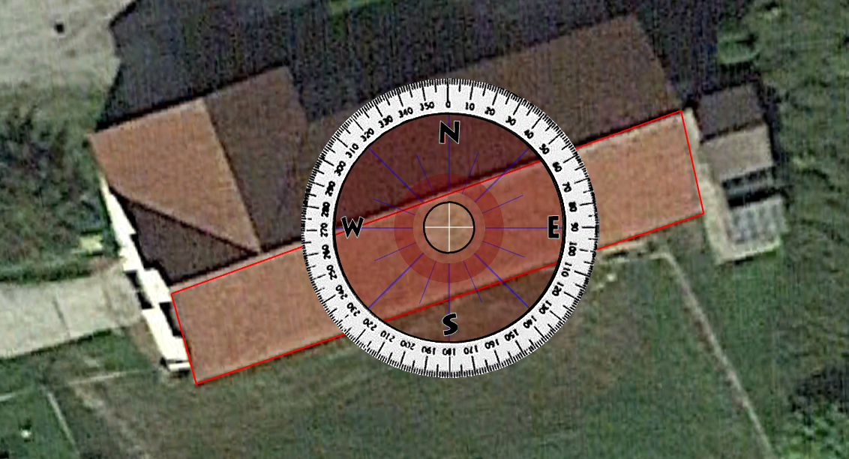
This roof is facing south-south-east, so it’s a good option

Slide 12
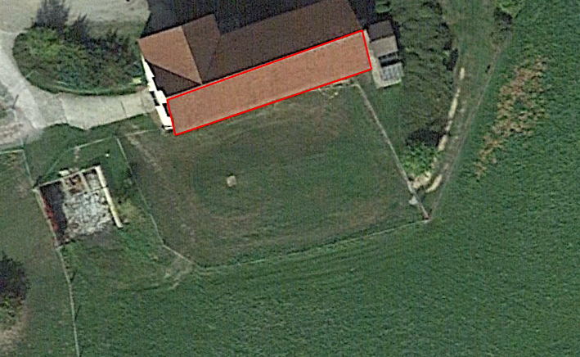
Is there any shading? No, there are no chimneys on the roof or trees in front of it. This roof will work.

Slide 13
Challenge!
Use google earth to pick the best roof on your school for Solar PV.
Remember, think about roof space, what direction the roof is facing and whether anything will cast a shadow on the roof (i.e. trees)

